Slide 1
Anne Philips
Lab meeting 3-9-09

Slide 2
“Carcinoma-produced factors activate myeloid cells through TLR2 to stimulate metastasis”
Sunhwa Kim, Hiroyuki Takahashi, Wan-Wan Lin, Pascal Descargues, Sergei Grivennikov, Youngjun Kim, Jun-Li Luo & Michael Karin. Nature 2009, Vol 457: 102-107

Slide 3
Introduction:
Distant site metastases are the leading cause of cancer mortality
Metastatic progression depends on
- genetic alterations within cancer cells (intrinsic)
- the inflammatory microenvironment of advanced tumors (extrinsic)
Aim:
To understand how cancer cells affect the inflammatory microenvironment
Strategy:
Conduct a biochemical screen for macrophage activating factors secreted by metastatic carcinomas

Slide 4
I. Examine whether cancer cells secrete factors that directly activate myeloid cells to produce tumor-promoting cytokines
Procedure:
- collected serum-free conditioned medium from 4 cancer cell lines
1. 1C1C7 – Liver cancer cell line (little or no metastatic activity)
2. TrampC1 - prostate cancer cell line (little or no metastatic activity)
3. 4T1 – metastatic breast carcinoma
4. LLC - Lewis lung carcinoma
- applied it to bone marrow-derived macrophages (BMDM)
- assayed for production of interleukin-1b (IL-1b), IL-6 and TNF-α

Slide 5
BMDM were cultured with SFM or SFM conditioned by mouse carcinoma cells (conditioned medium). Production of (IL-1b), IL-6 and TNFα was measured.
Results: Conditioned medium from metastatic cells, especially LLC, induced higher amounts of IL-6 and TNF-a secretion than conditioned medium from non-metastatic cells
(IL-1b secretion was undetectable)
BMDM were cultured with SFM or LLC conditioned medium (LCM).
Cytokine mRNAs were measured.
Results: LCM induced expression of Il1b, Il6 and Tnfα mRNAs.
SFM was inactive

Slide 6
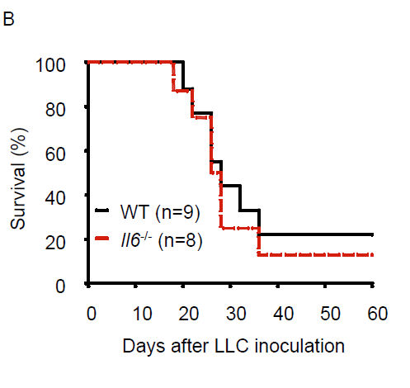
Tail vein injection of LLC into age and sex-matched Tnfα -/- and Il6 -/- mice and WT controls.
Tnfα -/- mice exhibited markedly reduced mortality compared with WT mice after inoculation with 1x10⁶ LLC cells
Little difference in survival of Il6-/- and WT mice inoculated with 1x10⁶ LLC cells (Supplementary Fig. 1b).

Slide 7
Lungs of WT and Tnfα -/- mice 47 days after LLC inoculation (2x10⁵ cells)
Tumor multiplicities are shown underneath (averages ± s.d, n=11, P<0.001 by Student’s t-test)

Slide 8
Conclusion:
Conditioned medium from metastatic cells, especially LLC, induced higher amounts of IL-6 and TNF-a secretion
TNF α but not IL-6 is important for LLC metastasis

Slide 9
II. Examined the involvement of TLR family members in sensing LCM components
Procedure:
Mice deficient in TLR2, TLR3, TLR4 or TLR9 or their adaptor proteins, Myd88 and TRIF
- isolated BMDM
- cultured with SFM or LCM
- measured production of IL-6 (a BMDM activation marker)

Slide 10
BMDM from indicated mice were cultured with SFM or LCM and IL-6 production was measured.
Results: IL-6 induction by LCM was fully dependent on TLR2 and Myd88 but not on TLR3, TLR4, TLR9 or TRIF
BMDM were treated with LCM of LPS (100ng/ml). Cell lysates were examined for Kinase phosphorylation (P) and 1kBα degradation by immunoblotting.
Results: TLR2 was required for optimal LCM-induced activation of mitogen activated protein kinases and IkB kinase or IkBα degradation

Slide 11
To identify co-receptors of TLR2:
- BMDM from indicated mouse strains were cultured with LCM or Pam3CSK4 (1ng/ml)
- IL-6 production was measured
Results: - LCM induced IL-6 production was dependent on TLR2, TLR6 and CD14 but not on TLR1
- Pam3CSK4, a bacterial lipoprotein analogue4, depended on TLR2 and TLR1 but not on TLR6 and CD14. These results rule out possible contamination with bacterial lipoproteins

Slide 12
To examine the in vivo role of TLR2:
-inoculated sex- and age matched Tlr2-/- and WT mice with 2x10⁵ LLC cells through the tail vein
-measured mRNAs encoding cytokines and chemokines in lungs.
Results:
Tnfα, Il1b, Il6 and inflammatory chemokine mRNAs were induced 5 days after LLC inoculation in WT lungs, peaking at 9 days after inoculation.
None of these mRNAs was induced in lungs of Tlr2-/- mice

Slide 13
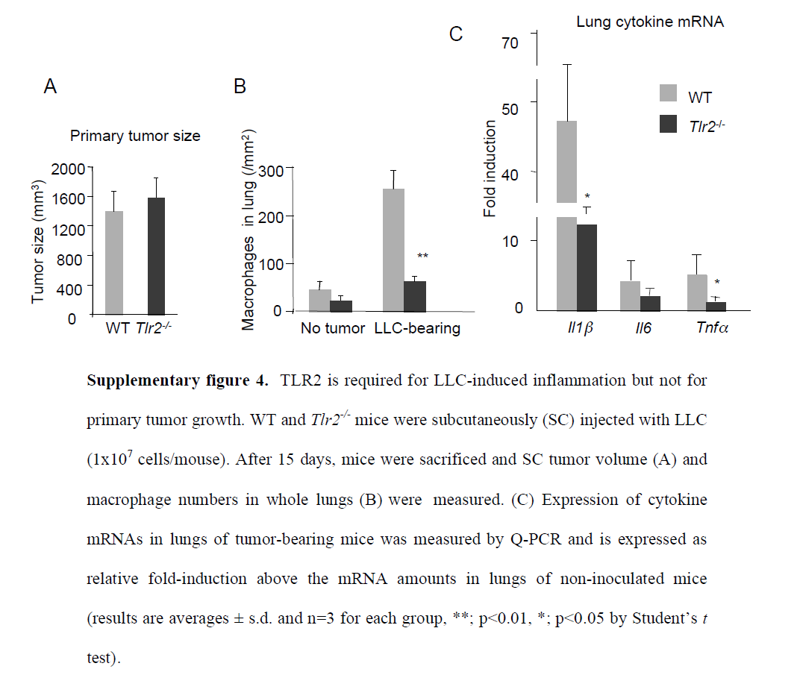
To examine the in vivo role of TLR2:
- Tlr2-/- and WT mice were subcutaneously inoculated with LLC cells
mice examined for lung macrophage infiltration and inflammatory cytokine gene expression 15 days later.
Results:
- no difference observed in primary subcutaneous tumor growth,
- macrophage infiltration and inflammatory cytokine gene expression were greatly reduced in Tlr2-/- mice compared with WT mice (Supplementary Fig. 4a–c).

Slide 14
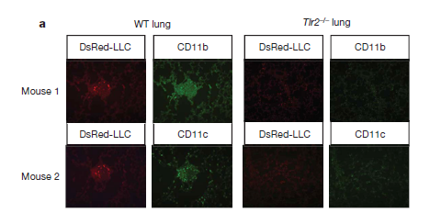
To investigate whether TLR2 signaling contributes to LLC metastatogenesis:
- inoculated age- and sex-matched Tlr2-/- and WT mice with dsRed-labelled LLC cells through tail vein
- examined lungs for micrometastases after 9 days (analyzed for dsRed and myeloid cell markers CD11b and CD11c)
Results: WT but not Tlr2-/- lungs showed small clusters of DsRed-LLC cells with adjacent CD11b+ and CD11c+ myeloid cells

Slide 15
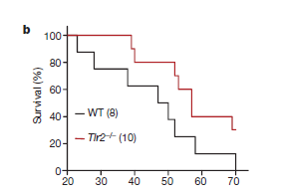
Tlr2-/- mice exhibited significantly greater survival than WT mice after LLC inoculation
Tlr2-/- mice contained fewer and smaller tumor nodules in their lungs than WT mice (tumor multiplicities shown on left)

Slide 16
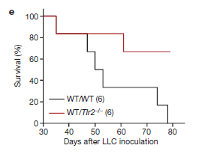
To investigate whether TLR2 acts in bone marrow-derived cells:
I
- mice were lethally irradiated (1050 rad)
- reconstituted with bone marrow from TLR2-/- or WT mice
- chimeric mice were inoculated with LLC
Results:
Mice reconstituted with Tlr2-/- bone marrow (WT/Tlr2-/-) exhibited markedly improved (P,0.04) survival compared with mice reconstituted with WT bone marrow (WT/WT)

Slide 17
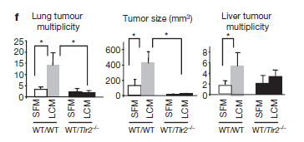
II
Bone marrow reconstituted mice (WT/Tlr2-/- and WT/WT) were inoculated with 2x10⁵ LLC cells followed by ip injections of LCM or SFM.
Results: Lung and liver tumor loads were significantly higher (P,0.05) in WT/WT mice receiving LCM than in those receiving SFM along with the LLC inoculum

Slide 18
Conclusion:
the pro-metastatic effect of LCM was dependent on TLR2 activation
little or no metastatic enhancement was seen in WT/Tlr2-/- mice.
LCM may contain TLR2-activating factors that enhance metastatogenesis

Slide 19
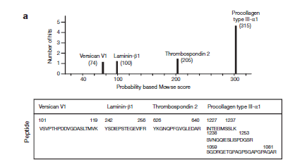
III. Identification of TLR2-activating factors in LCM:
- collected large amounts of LCM
separated on a mono-Q anion exchange column
monitored column fractions for their ability to induce IL-6 in BMDM
fractions with IL-6-inducing activity were pooled
Separated on a Superdex 200 sizing column
fractions with IL-6-inducing activity pooled, deglycosylated and subjected to mass spectrometry
Results: Identified several peptides derived from the extracellular matrix proteins:
- versican V1
- laminin-b1
- thrombospondin 2
- procollagen type III-a1

Slide 20
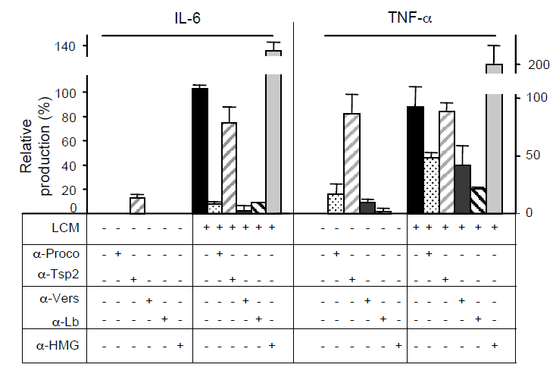
To examine which protein in LCM accounts for induction of inflammatory cytokines:
- incubated LCM with individual neutralizing antibodies before BMDM stimulation
- measured cytokine production.
Results:
Incubation of LCM with antibodies to procollagen type III-a1, versican or laminin-b1 significantly reduced IL-6 and TNF-α production
Thrombospondin 2 did not

Slide 21
To investigate the role of these proteins in LCM-enhanced metastatogenesis:
- generated stable LLC cell lines containing shRNAs to versican V1, laminin-b1 or procollagen III-a1
- cells injected into mice
- lung tumor nodules and survival monitored
Results:
Versican V1 silencing significantly reduced tumor multiplicity
Laminin-b1 silencing resulted in a modest inhibition
Procollagen III-a1 silencing slightly enhanced tumor multiplicity
Mice inoculated with versican-silenced LLC cells exhibited significantly improved survival

Slide 22
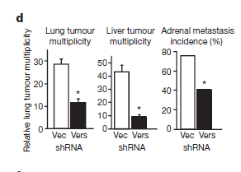
Silencing of versican reduced metastatic spread to lung, liver and adrenal glands in the subcutaneous implantation model

Slide 23
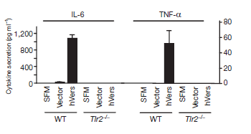
To examine how versican activates macrophages:
produced His-tagged human versican V1 in LLC cells
purified on Ni-chelate column
incubated BMDM without or with His-hVers for 20–24 h
cytokine secretion was measured
Results: His-tagged h-versican V1 induced IL-6 and TNF-a production in WT but not Tlr2-/- BMDM

Slide 24
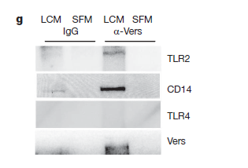
To investigate whether versican interacts with TLR2 or its CD14 co-receptor:
- Lysates of Raw264.7 cells were incubated with LCM or SFM for 1 h
- immunoprecipitated with versican-specific or control antibody
- analysed by immunoblotting with the indicated antibodies
Results:
- Immunoprecipitation of lysates of LCM-incubated Raw264.7 macrophages
with versican-specific antibody co-precipitated TLR2 and CD14 but not TLR4
- The versican antibody did not precipitate TLR2 unless the macrophages were first
incubated with LCM.

Slide 25
Conclusion:
Tumor cells
versican
CD14
TLR2
TLR6
Myeloid cells
TNF-α
TNF-α
TNF-α
TNF-α

Slide 26
Previous work:
Versican accumulates in tumor stroma and in cancer cells
Versican or fragments thereof can enhance tumor cell migration, growth and angiogenesis, processes that are relevant to metastasis
versican is highly expressed in non-small-cell lung cancer (NSCLC), especially in advanced disease with high recurrence rate
Increased versican expression is often observed in tumor growth in tissues such as breast, brain, ovary, gastrointestinal tract, prostate, and melanoma

Slide 27
Does versican act directly on TLR2 or through a ligand?
- Versican may act through hyaluronan (a polymer of glycosaminoglyan units)
Evidence:
1. Versican can bind hyaluronan
2. Versican and hyaluronan are highly expressed in certain cancers (esp NSCLC)
3. Hyaluronan fragments can activate macrophages through TLR2
4. Hyaluronan accumulation has been linked to tumor progression and metastasis
5. Enzyme hyaluronidase has been linked to metastasis

