Slide 1
Anne Philips
Lab Meeting
3-2-2009

Slide 2
PROJECT OUTLINE
I. Aim
II. Background
III. Strategy
IV. Long term
V. Materials/protocols
VI. Short term

Slide 3
AIM
Study the role of macrophages in a mouse model for ovarian cancer.
characterizing the changes at the mRNA and protein level that occur in tumor associated macrophages (ID8 model)
compare to proteins expressed in macrophages present in peritoneal fluid under basal conditions and in inflammation (thioglycollate) model

Slide 4
Background
“Macrophages: Obligate Partners for Tumor Cell Migration, Invasion, and Metastasis”
John Condeelis and Jeffrey W. Pollard. Cell 124, January 27, 2006
Macrophages are present in the tumor microenvironment
factors produced by macrophages can contribute to both tumor growth and antitumor immune activities
Macrophages within the tumor microenvironment facilitate angiogenesis and extracellular matrix breakdown and remodeling and promote tumor cell motility
in many human cancers, a high density of tumor associated macrophages (TAMs) correlates with poor prognosis

Slide 5
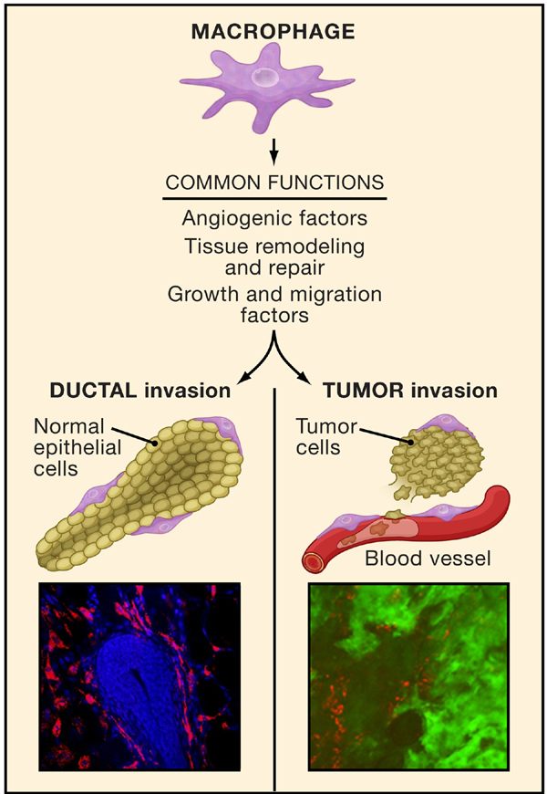
Figure 1. Tumor Cells Co-opt Macrophage Functions
Macrophages aid in the invasion of epithelial cells during morphogenesis (left) and are co-opted by tumor cells during metastasis (right). Multiphoton image at the bottom left: epithelial cells (blue) of a terminal end bud in a mouse mammary gland during normal glandular development.
The bud is surrounded by macrophages (red) that precede the invasion of the fat pad by the epithelial cells. Multiphoton image at the bottom right: tumor-associated macrophages (red) and tumor cells (green) at an invasive edge in a mouse mammary tumor. Adapted from Wyckoff et al.
(2004) and Lin et al. (2002).

Slide 6
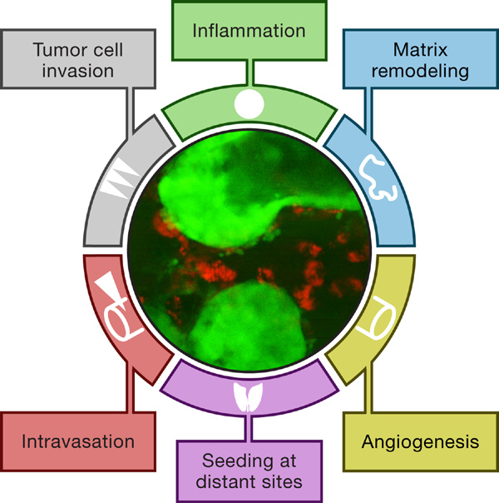
Figure 2. Six Traits for Malignancy Promoted by Macrophages
Tumors direct macrophages to adopt a trophic role that facilitates six
traits that are extrinsic to the intrinsic genetic changes of tumor cells. The
wheel (in deference to Hanahan and Weinberg, 2000) can turn in either
direction, allowing macrophages to contribute to invasion, intravasation,
angiogenesis, and extravasation equally. The image in the center is a
multiphoton micrograph of a mammary tumor (green) and associated
macrophages (red) in a living mouse.

Slide 7
Useful properties of macrophages:
do not harbor malignant mutations and therefore have a stable genome
much less likely to develop drug resistance
develop anticancer therapies by targeting signaling pathways that allow macrophages to contribute to tumor progression, invasion and metastasis

Slide 8
Strategy:
study gene expression in TAMs
compare to basal macrophages
evaluate which proteins are up- / down- regulated in TAMs
over-express or knock-down proteins in ID8 cells – follow tumor progression
over-express or knock-down proteins in BMDM – adoptively transfer into mice
and evaluate tumor formation and progression

Slide 9
Techniques:
Proteins: - mass spectrometry to profile and quantify total proteins (Ref 2)
- profile and quantity phospho-proteins (Ref 3)
- identify novel alternative splice isoforms (Ref 4)
Gene expression:
Evaluate macrophage mRNA from basal, inflammatory and tumor elicited populations
gene expression microarrays
- rely on sequence specific probe hybridization
(limited by high background, cross-hybridization, measures only relative amounts of transcripts) (Ref 5)
tag-based sequencing
-Digital Gene Expression tag profiling (Ref 6)
-deep sequencing based expression analysis which allows simultaneous sequencing of up to millions of different DNA molecules

Slide 10
Materials:
Mouse experiments:
ID8 cells (expressing luciferase gene)
C57BL/6 mice
Proteomics and gene expression profiling:
100 ug protein for MS analysis
1 ug RNA for deep sequencing or microarray analysis (Ref 6)

Slide 11
Animal protocol:
C57BL/6 mice:
1) Basal state: Macrophages will be harvested from wild type mice
2) Inflammation model: Mice will be injected with thioglycollate and macrophages harvested after 4 days
3) Tumor model: Mice will be inoculated with ID8luc cells and allowed to develop a tumor burden. Mice will be imaged weekly
Expected yield of peritoneal macrophages:
1) Basal peritoneal macrophages: ~ 3 x 10⁶ cells containing approximately 50-70% macrophages per mouse
2) Thioglycollate elicitated macrophages: ~8-12 x 10⁶ cells containing approximately 70% macrophages 4 days after IP injection
3) ID8 induced macrophages: ~3-5 x 10⁶ cells containing (?) % macrophages 8 weeks after IP injection

Slide 12
SHORT TERM
RAW264.7 cells
(BALB/c mouse macrophage cell line established from a tumor induced by Abelson murine leukemia virus.
RAW 264.7 cells will be used to optimize protocols and experimental conditions
1. Isolate total protein and RNA from cells
mass spectrometry to profile and quantify proteins
Deep sequencing based expression analysis to characterize mRNA
2. Characterize phosphoproteins from ligand-stimulated cells

Slide 13
Lentiviral transfection of ID8 cells with luciferase gene
1. Modified lentiviral vector pHR-SIN-CSGW dlNotI (from Dr. Y. Ikeda, Mayo Clinic, Rochester, MN) digested with BamHI-Not I to remove GFP.
2. Inserted Luc+ gene removed from pGL3-Basic (Promega) by restriction with Bgl II-Eag I, forming the vector pHRSINCSLuc+W.
3. Lentivirus particles generated by triplicate cotransient transfection of 293T cells (3 x 10⁶) with:
a) Plasmid encoding the VSV-G envelope *
b) plasmid encoding gag-pol genes *
c) pHRSINCSLuc+W
by the calcium phosphate precipitation method.
4. ID8 cells will be transfected with lentiviral particles

Slide 14
References:
1. “Macrophages: obligate partners for tumor cell migration, invasion, and metastasis.” Condeelis J, Pollard JW, Cell 2006, 124:263–266
2. “Contribution of protein fractionation to depth of analysis of the serum and plasma proteomes”
Victor Faca, et al. Journal of Proteome Research 2007, 6. 3558-3565
3. “Highly selective enrichment of phoshorylated peptides using titanium dioxide”
Thingholm, T. et. al. Nature protocols. 2006. Vol 1. No 4. 1929-1935
4. “Identification of novel alternative splice isoforms of circulating proteins in a mouse model of human pancreatic cancer”
Menon, R , et.al. Cancer Res 2009;69: (1). 300-309
5. “High- density gene expression analysis of tumor associated macrophages from mouse mammary tumors”
Ojalvo, L., et.al. The American journal of Pathology, 2009 . Vol 174, No.3, 1048-1064
6.“Deep seq-based expression analysis shows major advances in robustness, resolution and inter-lab portability over five microarray platforms” ‘t Hoen, et. al. Nucleic Acids Res. 2008. Vol. 36, No. 21

