Slide 1
Fig 3d methods
Stanley’s protocol for “pure” myeloid progenitors
D2 or D3 cells seed in 24 well plate
48h with CSF-1
Count cells (day 0) and culture
4d in LCCM
Count cells

Slide 2
BM transduction
Transduce Day 3 BM cultures with retrovirus x 24h
Culture for 1 day
Sort for GFP or YFP
Culture overnight
Cells used for experiments

Slide 3
Bone Marrow transplant
Recipient WT mice lethally irradiated with 950 rads
Donor mice:
BM cells from femurs/tibiae ACK treated and depleted of CD4+ and CD8+ T cells
1:1 mix of:
a) WT-GFP+/+ : WT-GFP-/-
b) WT-GFP+/+ : KO-GFP-/-
i.v. injection
Monitor GFP expression in BM, blood and peritoneum at 12 wks, 19 wks, 36 wks
Look at GFP- to GFP+ ratio (GFP+ is always WT)
This is a competitive repopulation experiment

Slide 4
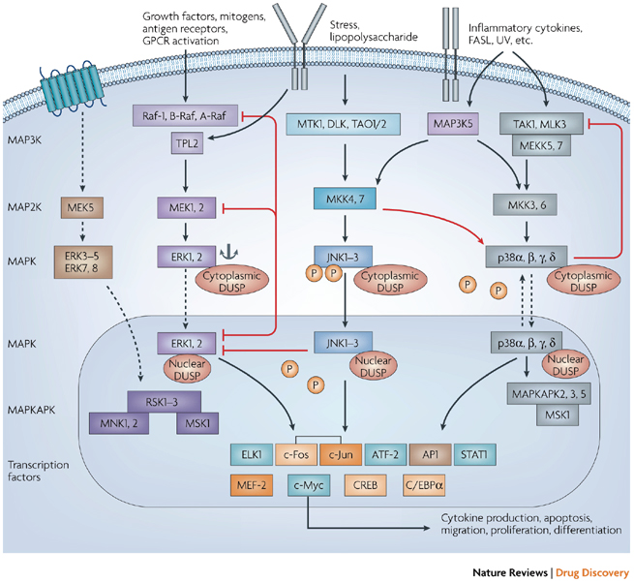
MKP-1 is DUSP1
At least 16 DUSPS regulate MAPK pathways
Jeffrey et al. Nat Rev Drug Discovery 6:391, 2007

Slide 5
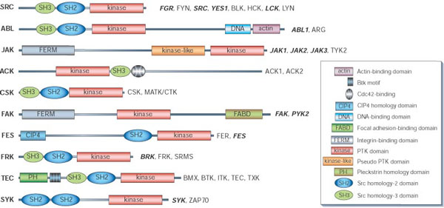
Pyk2 = Ptk2b = CAKbeta
humans: 32 non-receptor PTKs in 10 subfamilies
Pyk2:
Non receptor PTK
Expressed mainly in the CNS and hematopoietic cells
Activated by calcium (probably via CaMK) and by stress signals
Undergoes pTyr in response to adhesion
Blume-Jensen & Hunter, Nature 411:355, 2001

