Slide 1
Macrophage colony-stimulating factor induces the proliferation and survival of macrophages via a pathway involving DAP12 and β-catenin
Karel Otero, Isaiah R Turnbull, Pietro Luigi Poliani, William Vermi, Elisa Cerutti, Taiki Aoshi, Ilaria Tassi, Toshiyuki Takai, Samuel L Stanley, Mark Miller, Andrey S Shaw & Marco Colonna
Washington University School of Medicine, St Louis, MI
Angel Lee JC, 7-20-09

Slide 2
This paper
Objective:
Define a mechanism that links DAP12 deficiency to the CNS defect in Nasu-Hakola disease, focusing on the role of the microglia
Findings:
DAP12-/- mononculear phagocytes show defective CSF-1 dependent proliferation and survival. One possible mechanism is that CSF-1 cooperates with DAP12 to mediate β-catenin dependent gene transcription
In vivo, DAP12-/- mice have fewer microglia in the basal ganglia and spinal cords at old age and they produce fewer myeloid cells after bone marrow transplant
Conclusions:
CSF-1 and DAP12 pathways cooperate to induce β-catenin dependent transcription of genes important for proliferation and survival of mononuclear phagocytes and this may explain the diminished numbers and survival of microglia in selected areas of the brain. This supports a functional role for DAP12 in the pathogenesis of Nasu-Hakola disease

Slide 3
Previously, in osteoclasts
Zou, Reeve, Liu, Teitelbaum, & Ross, Mol. Cell 31:422, 2008
CSF-1 stimulation of osteoclasts induced the formation of a complex containing phosphorylated DAP12 and Syk
Complex formation required Src binding at Y559 in the CSF-1R
Proposed pathway: CSF-1 -> CSF-1R -> Src-> DAP12 -> Syk
Osteoclast function (actin cytoskeleton, resorptive lacunae) depends on the DAP12 ITAM motif and the Syk SH2 domains

Slide 4
Pathway#1

Slide 5
Hume et al. Blood 101:1155, 2003
microglia
osteoclasts

Slide 6
DAP12, DNAX activating protein of 12 kDa
Pathway#2
Expressed on NK and myeloid cells (including osteoclasts and microglia)
Originally identified based on homology to TCR associated CD3 and FcR-γ
Homology limited to the ITAM (immunoreceptor tyrosine based activation motif) in the cytoplasmic tail, the only known signaling motif
114 amino acids, short ECD (13-17 aa), TM and cytoplasmic tail
Disulfide linked homodimer and associates with receptors through salt bridging in the TM region
Proposed to have both activating and inhibitory influences on effector functions depending on avidity of receptor ligation
Recent view is that ITAM coupled receptors modulate the amplitude and nature of macrophage responses to TLRs and cytokine receptor stimulation
DAP12 knockout:
Apparently normal hematopoiesis
Defective immune response (resistant in an autoimmune model); defective NK cell mediated cytotoxicity against tumor cells; literature supporting both an amplification as well as an attenuation role of the inflammatory response
develop osteopetrosis (deficient osteoclast function due to defective differentiation), as early as 6 weeks
status of microglia vary in the 3 strains of knockout mice with one study reporting problems with oligodendrocytes (myelination)

Slide 7
Role of DAP12 in human disease
Nasu-Hakola disease (NHD)
Polycystic lipomembranous osteodysplasia with sclerosing leukoencephalopathy
Genetically heterogenous : systemic bone cysts and presenile dementia (by age 30 and dead by age 40-50)
Recessive mutation in DAP12 or its associated receptor TREM2 (Triggering receptor expressed on myeloid cells-2)
DAP12: a 5.3 kb genomic deletion (Finnish); a single base deletion in Exon 3 (one Japanese pt) -> no functional protein

Slide 8
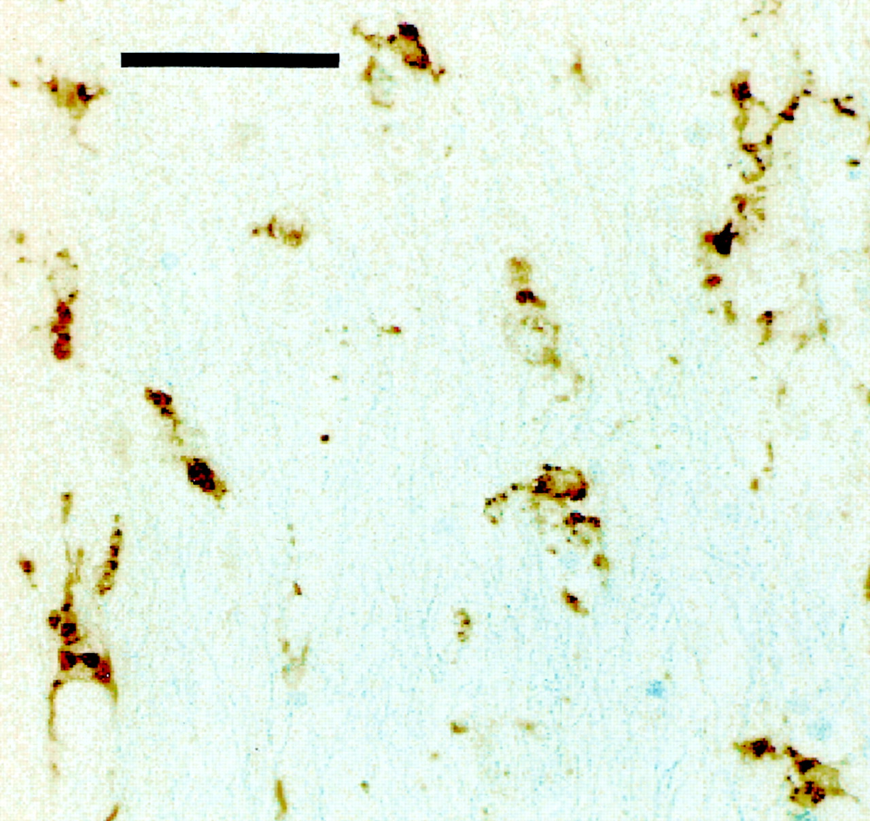
Activated microglia in the deep frontal white matter in a pt with Nasu-Hakola disease
Stained for CD68, a pan macrophage antigen
- Not sure why they think the microglia are activated based on this
Paloneva BM, J. et al. Neurology 2001;56:1552-1558

Slide 9
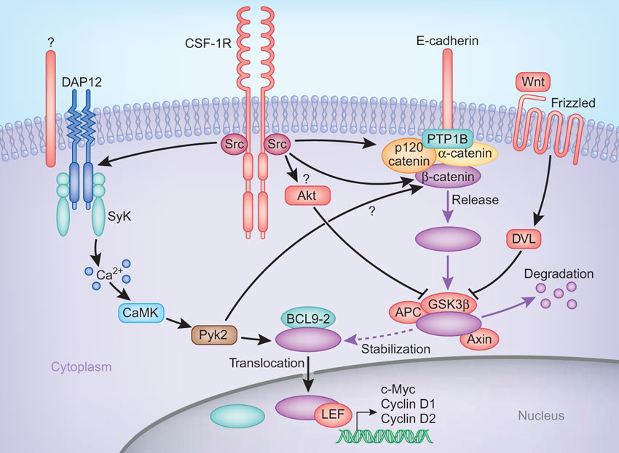
Cross talk between the CSF-1R and DAP12 pathways in macrophages
Receptor tyrosine
kinase
ITAM adaptor
β-catenin
β-catenin
β-catenin
β-catenin
McVicar & Trinchieri Nat Immunol. 10:681, 2009

Slide 10
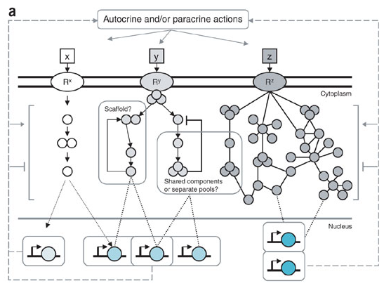
Signaling networks
Membrane receptors
Cytoplasmic signaling
intermediates
Transcription factors
Linear
Branched
Network
Fraser & Germain Nat. Immunol. 10:327, 2009

Slide 11
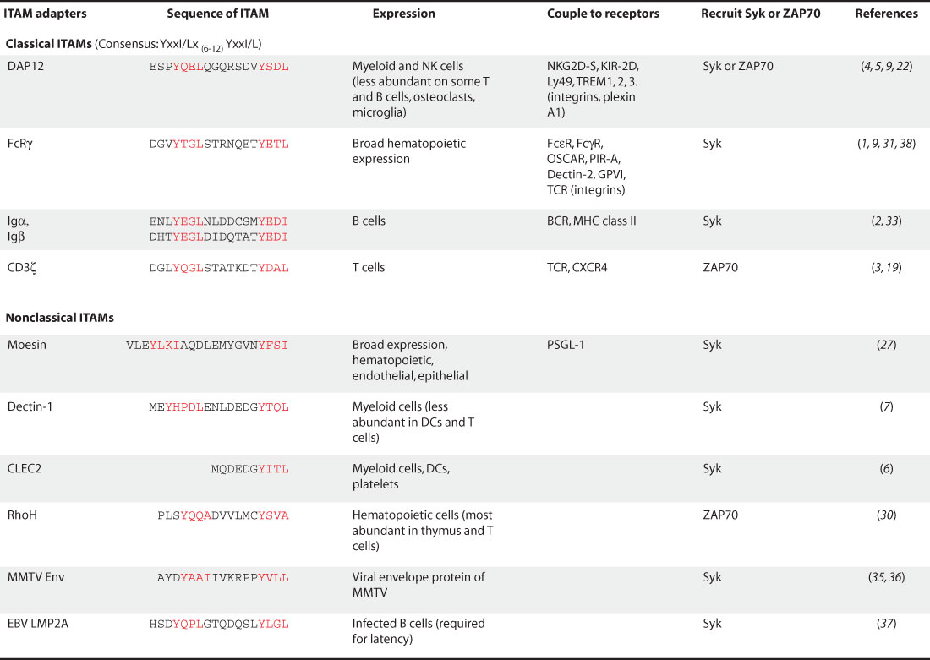
ITAM containing proteins in immune cells
Pathway#2
Classical ITAM sequence:
YxxI/Lx₍₆₋₁₂₎YxxI/L
Abram & Lowell STKE, 2007

Slide 12
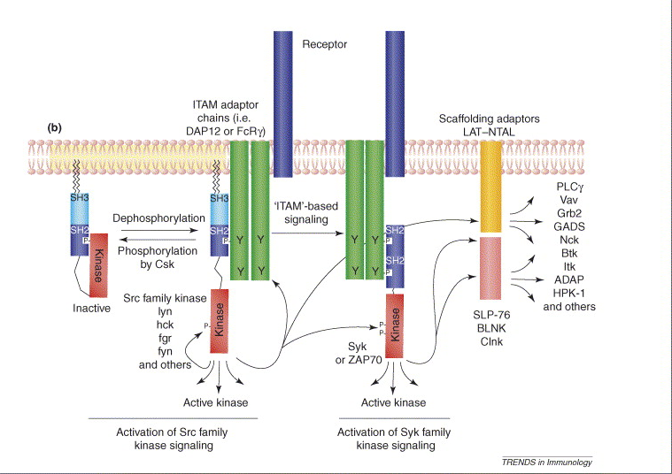
DAP12 signaling
DAP12
DAP12
DAP12
DAP12
Non receptor PTKs
Underhill and Goodridge, Trends Immunol. 28: 66, 2006

Slide 13
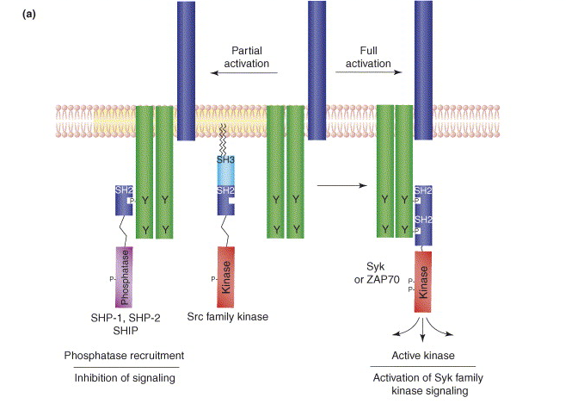
Avidity of receptor ligation determines activating or inhibitory output from DAP12
DAP12
DAP12
DAP12
DAP12
DAP12
DAP12
Underhill and Goodridge, Trends Immunol. 28: 66, 2006

Slide 14
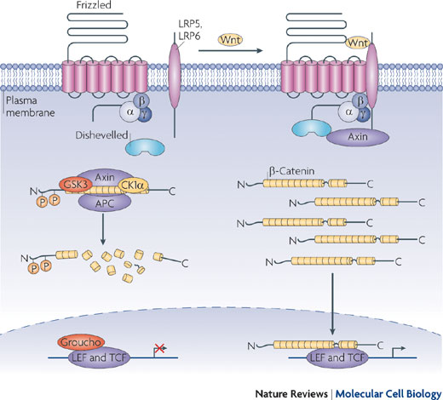
Pathway#3
Wnt-β-catenin canonical signaling pathway
Repressed state
Active state
Function:
Development, adult stem and progenitor cell proliferation, regeneration, cancer, degeneration
Wnts:
- 19, conserved secreted glycoproteins
- ligands for the Frizzled family (10)+co-receptors, LRP5, LRP6
- Wnt binding to Frizzled/LRP5,6 activates the canonical pathway
Wnt can also bind to Frizzled w/o LRP5,6 to activate the non-canonical pathway involved in diverse processes e.g. planar cell polarity
Wnt can also activate RTKs ROR2, RYK: Wnt5a binds to ROR2 and activate JNKs
SCF complex
β-catenin:
- Member of the Armadillo repeat protein superfamily;
N-terminus is phosphorylated by GSK3
in the presence of Wnt ligand, β-catenin escapes degradation and translocates to nucleus
in nucleus, displaces TCF bound co-repressors from WREs, function as scaffold to recruit additional co-activators
target genes: cyclin D1, c-Jun, c-Myc, E-cadherin, EGFR
TCF = T-cell factor
LEF = lymphoid enhancer factor
Angers and Moon Nat. Rev. Mol. Cell Biol. 10:468, 2009
Destruction complex:
Axin, APC, GSK3β, CKI, PP2A
SCF complex:
SKP1, Cullin, F-box (β-TrCP), a multisubunit E3 ubiquitin ligase

Slide 15
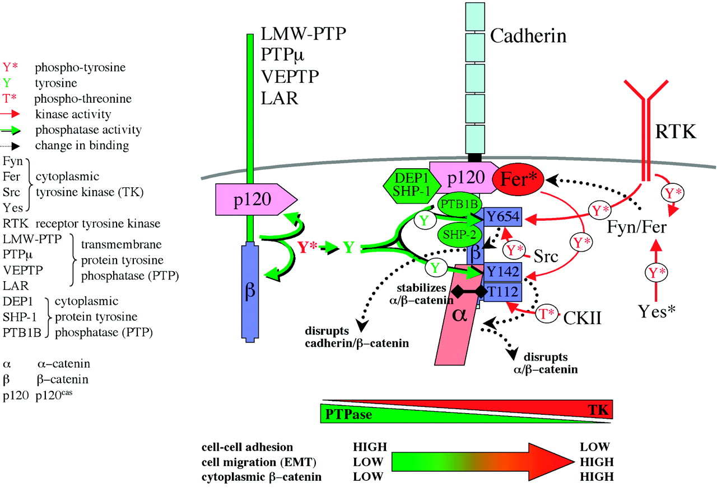
Cadherin can influence Wnt-β-catenin signaling
Nelson and Nusse Science 303: 1483, 2004

Slide 16
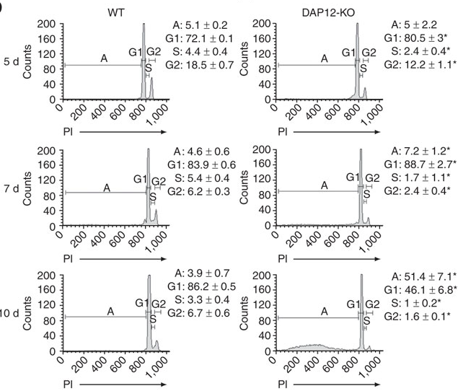
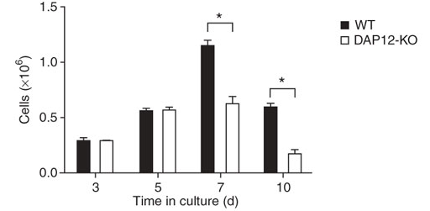
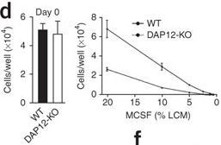
Decreased proliferation and increased apoptosis of DAP12-/- BMMs
Continuous growth
Fig. 1
Cell numbers
Cell cycle analysis using PI
Fig. 3 Using “pure” cultures of myeloid precursors

Slide 17
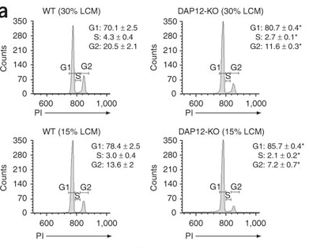
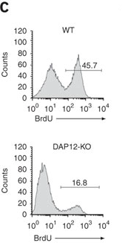
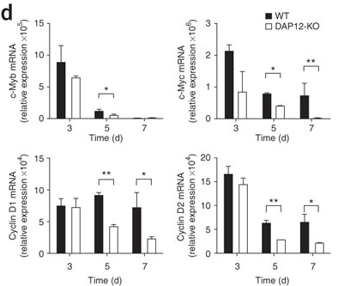
Cell cycle analysis of day 5 cultures
DNA content: Comparing 15% vs 30% LCCM
DNA synthesis: BrdU uptake
Gene induction
Fig. 2

Slide 18
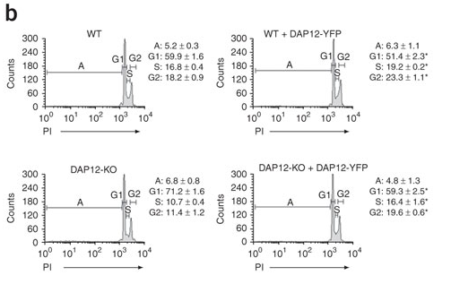
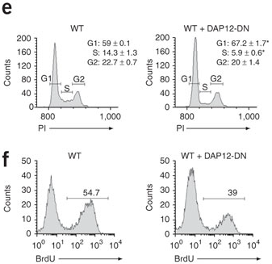
WT-DAP12 rescues DAP12-/- while DN-DAP12 inhibits DAP12+/+ proliferation
Retroviral reconstitution of DAP12-/- BMMs
with DAP12
Retroviral reconstitution of DAP12+/+BMMs
with DN-DAP12
Fig. 2

Slide 19
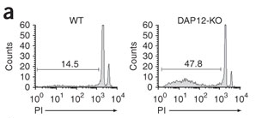
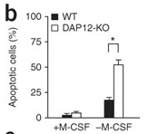
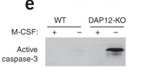
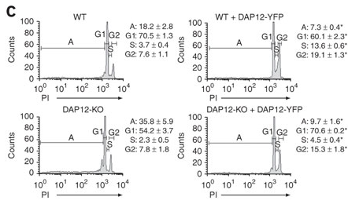
DAP12-/- BMMs have defective survival
No CSF-1 x 24h
No CSF-1 x 16 h
Transduced BM cells w/- CSF-1 x 24h
Fig. 3

Slide 20
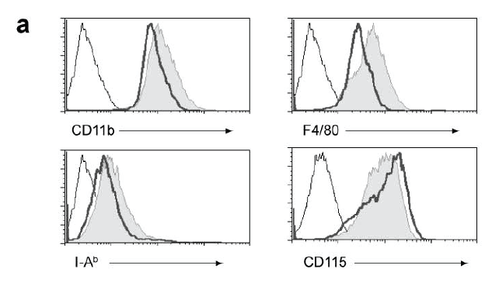
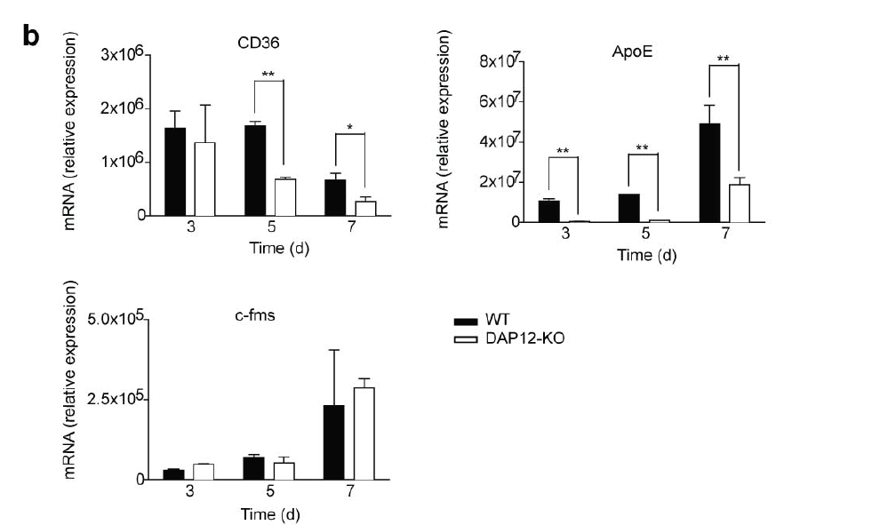
Normal differentiation of DAP12-/- BM cells to BMMs
Day 5 BM
CD36: Scavenger receptor
Fig. S1

Slide 21
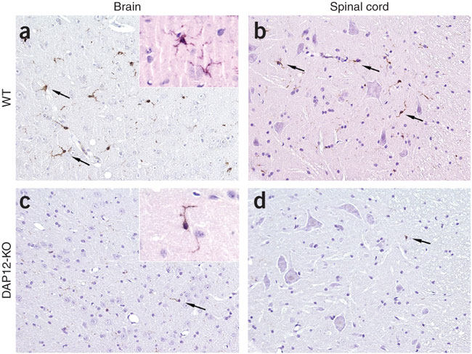
Loss of microglia in CNS of older DAP12-/- mice
DAP12-/- :
-No diff @ 4 wk
-microglia show cytorrhexis and nuclear condensation
Iba-1
-ionized calcium binding adaptor molecule-1
Located within a segment of the MHC III region
Specifically expressed in macs and microglia
Expressed weakly in brain but specific for microglia in the brain
61.2 per mm²
37.3 per mm²
10.6 per mm²
6.2 per mm²
Fig. 4

Slide 22
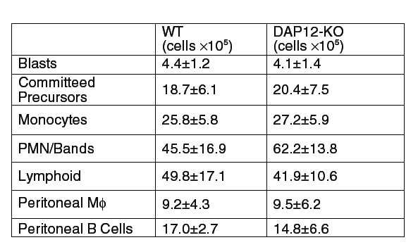
No defect detected in steady state myelopoiesis in DAP12-/- mice
Unfractionated BM:
CD31^{hi}Ly6C⁻
CD31+Ly6C+
CD31-Ly6C^{hi}
CD31-Ly6C+
Note this is a very minimal analysis of myelopoiesis
Table S1

Slide 23
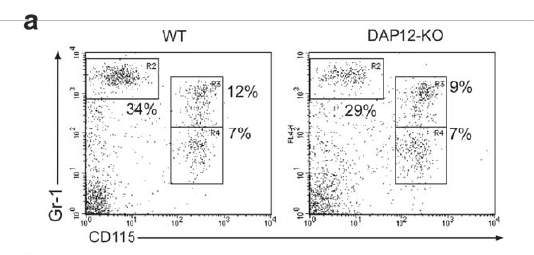
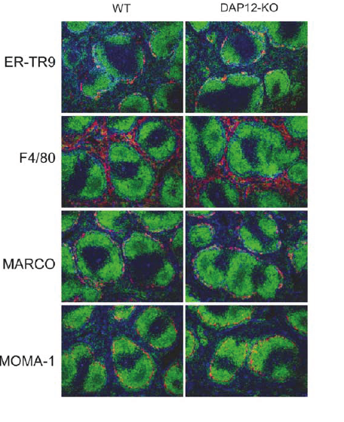
No difference in monocyte/macs in blood and spleen between WT and DAP12-/- mice
Blood
Spleen
Fig. S2

Slide 24
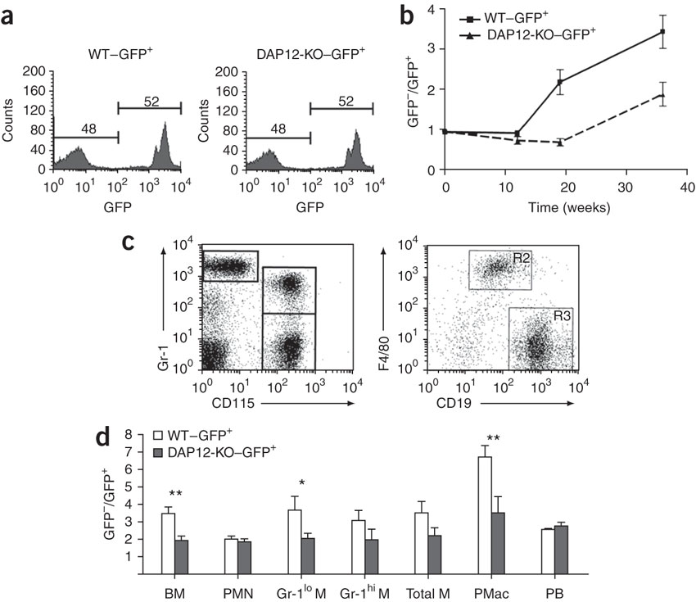
Less efficient engraftment w/ DAP12-/- BM cells
12 weeks
BMT protocol
Bone Marrow
PMNs
monos
Mac
Blood and Peritoneum
monos
B cells
Subsets
36 weeks
Fig. 5

Slide 25
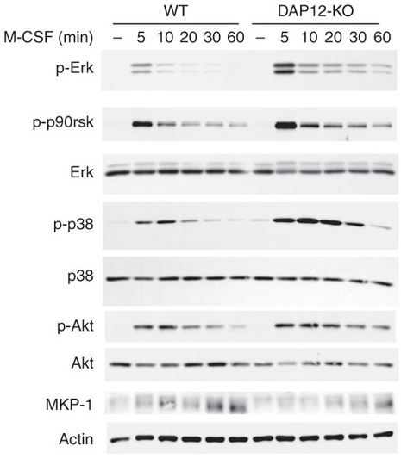
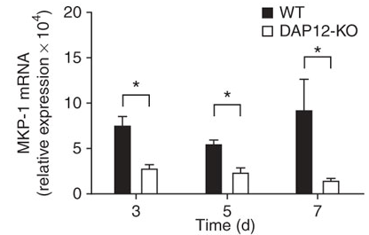
CSF-1 induced Erk activation is increased in DAP12-/- BMMs
MKP-1 is a dual specific phosphatase acting on p38, JNK and Erk
=> In DAP12-/- cells, CSF-1 induces less MKP-1, therefore increases Erk, p38 phosphorylation;
=> Erk activity is not correlated w/ DAP12-dependent BMM proliferation and survival
Fig. 6

Slide 26
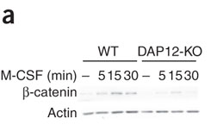
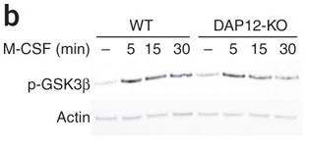
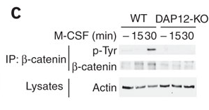
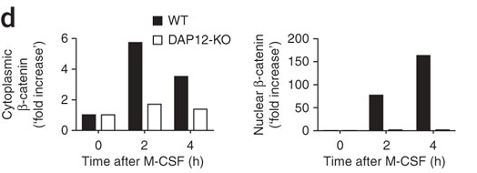
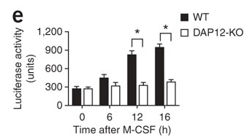
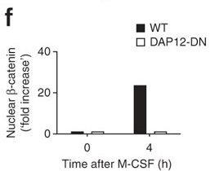
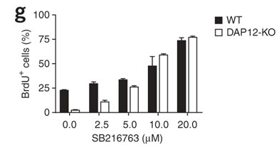
DAP12 is required for CSF-1 activation of the β-catenin pathway
β-catenin protein levels
GSK3b phosphorylation
β-catenin tyr phosphorylation
Reporter assay for β-catenin activity
β-catenin nuclear translocation
BrdU uptake +/- GSK3b inhibitor
Fig. 7

Slide 27
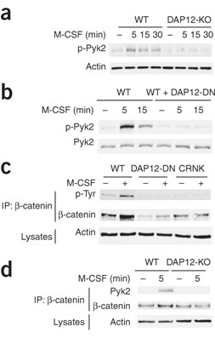
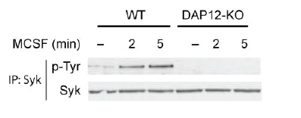
DAP12 -> Pyk2 -> β catenin
Where is Pyk blot?
Previous figure:
DAP12 is required for β catenin expression
CSF-1 induces pTyr of β catenin
Cant’ say that DAP12 is involved in CSF-1-dependent β catenin pTyr
Now authors want to establish a link between DAP12 and β catenin pTyr –they are zeroing in on Pyk based on the known relationship between DAP12 and Pyk.
CSF-1 also induced Syk pTyr and Syk inhibitor reduces BMM proliferation but doesn’t co-IP with β-catenin; so the authors say Syk is upstream of Pyk-β catenin
However, it is not clear how they can exclude a role for a direct CSF-1 dependent mechanism; can only say that DAP12-Pyk is required but may not be sufficient for β catenin pTyr
Fig. S3
Co-IP between Pyk2 and β-catenin
Fig. S3
Fig. 8

Slide 28
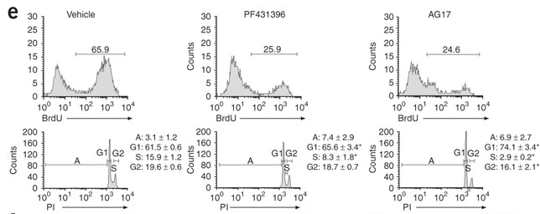
Inhibition of Pyk2 activity reduces CSF-1 dependent BMM proliferation
Pyk inhibitors
DN-Pyk
Fig. 8

Slide 29
Cross talk between the CSF-1R and DAP12 pathways in macrophages
Receptor tyrosine
kinase
?
ITAM adaptor
?
R/O CSF-1 induced Wnt ?
?
β-catenin
?
β-catenin
β-catenin
Other DAP12- dependent pathways ?
β-catenin
McVicar & Trinchieri Nat Immunol. 10:681, 2009

